Slide 1

TEAM MEMBERS
AHMET SERHEND YILMAZ
LIMO KEMEI

Slide 2


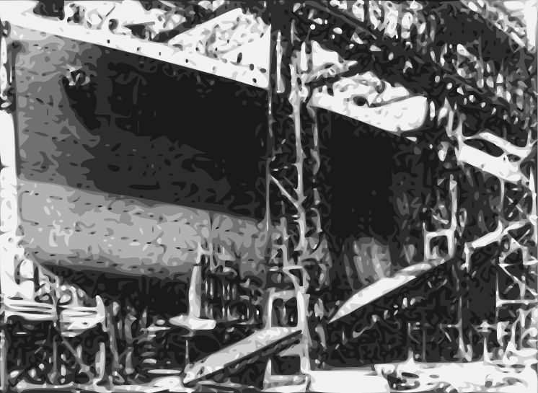






CONSTRACTION, LAUNCH AND FITTING-UP
The sheer size of Titanic and her sister ships posed a major engineering challenge for Harland and Wolff; no shipbuilder had ever before attempted to construct vessels this size. The ships were constructed on Queen's Island, now known as the Titanic Quarter, in Belfast Harbour. Harland and Wolff had to demolish three existing slipways and build two new ones, the largest ever constructed up to that time, to accommodate both ships. Their construction was facilitated by an enormous gantry built by Sir William Arrol & Co., a Scottish firm responsible for the building of the Forth Bridge and London's Tower Bridge. The Arrol Gantry stood 228 feet (69 m) high, was 270 feet (82 m) wide and 840 feet (260 m) long, and weighed more than 6,000 tons. It accommodated a number of mobile cranes. A separate floating crane, capable of lifting 200 tons, was brought in from Germany.
210k
50k
followers
followers

Slide 3

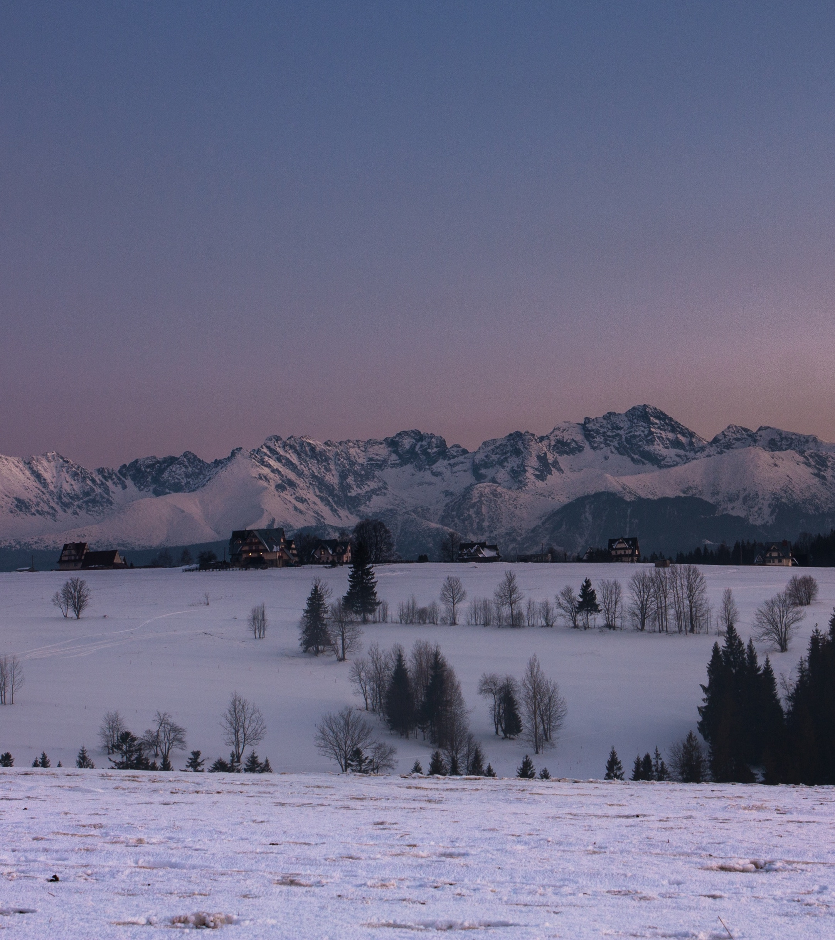


Big shaq
adventures
PROVIDING THE BEST SOLUTIONS

